Slide 1
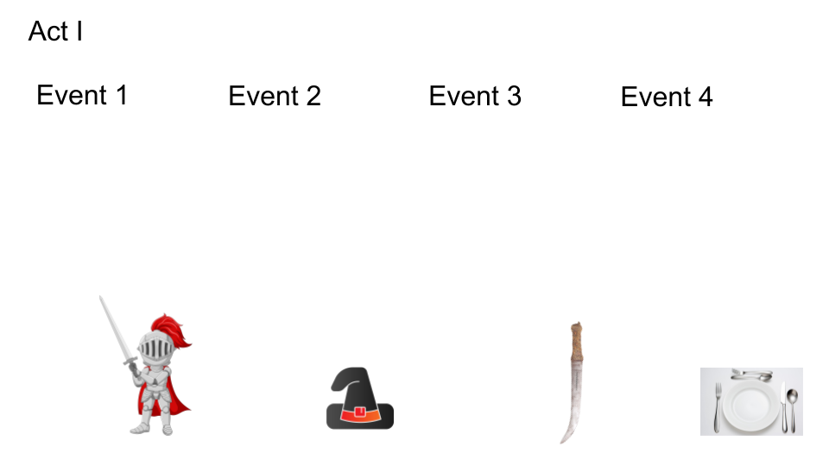
Insert text
Insert text
Insert text
Insert text

Slide 2
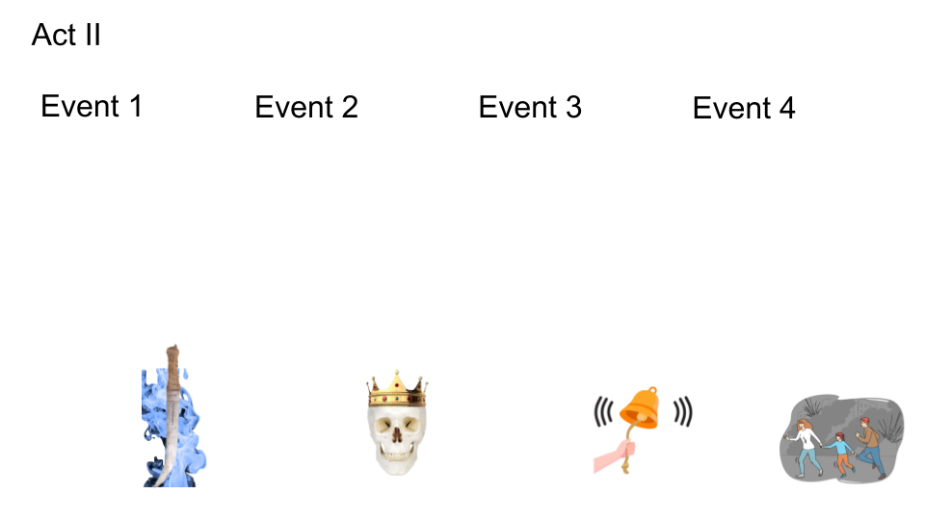
Insert text
Insert text
Insert text
Insert text

Slide 3
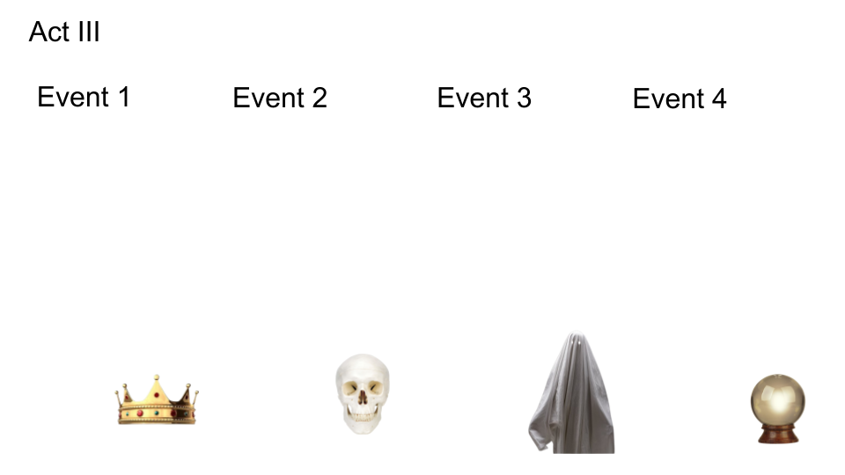
Insert text
Insert text
Insert text
Insert text

Slide 4
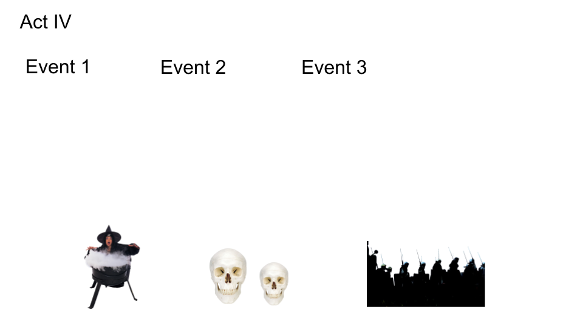
Insert text
Insert text
Insert text

Slide 5
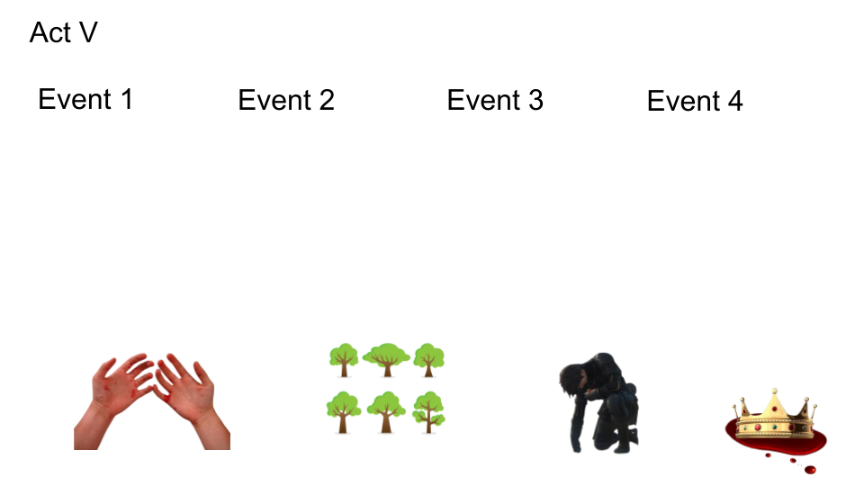
Insert text
Insert text
Insert text
Insert text

